Slide 1
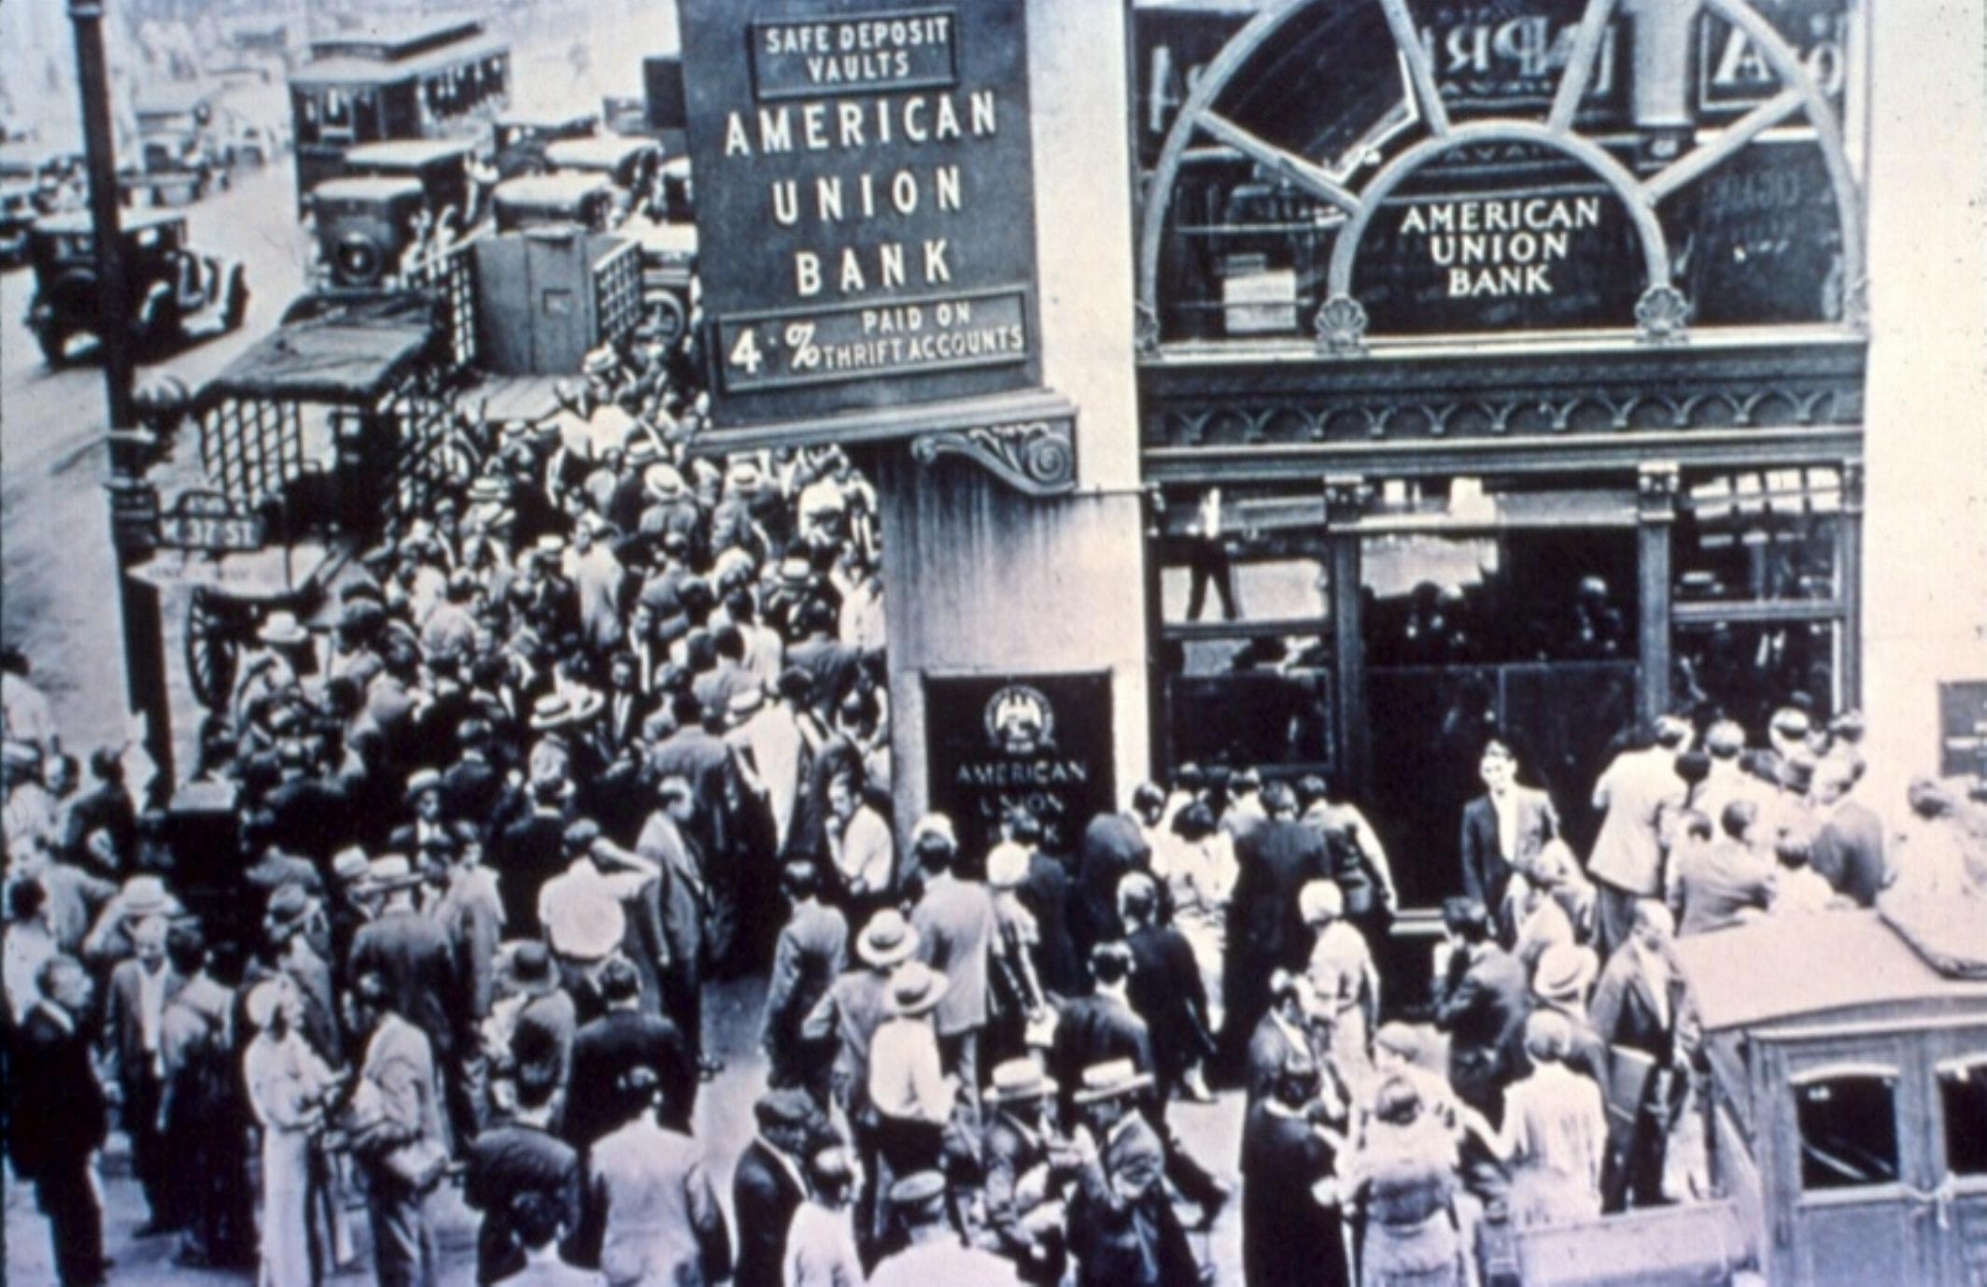
Class 25:
Proof of Reserve
Cryptocurrency Café
UVa cs4501 Spring 2015
David Evans
New York City, 1929

Slide 2
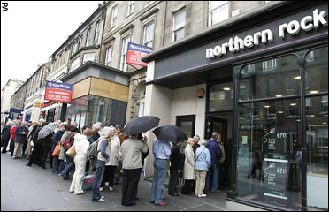
Plan
Multiplicative Magic of Banking
Proof of Reserve: Jack Doerner
London 2007

Slide 3
Project Presentations Start Monday
15 minutes each team
Send me presentation for posting
An Analysis and Breakdown of SHA Hashing in Bitcoin
Jeremy Gabalski
Financial Markets, Game Theory, and Self-Regulation
Merlin Zhang, Trisha Hajela
Kickstarting PointCoin
Jake Shankman
Studying Coinbase Reserves as a means of Predicting Market Price
Alex Coffin, Ankit Gupta, Tara Raj, Corrigan Blanchfield
Subsidy Studies
Laurence Meyers, Jacob Rosenberg

Slide 4
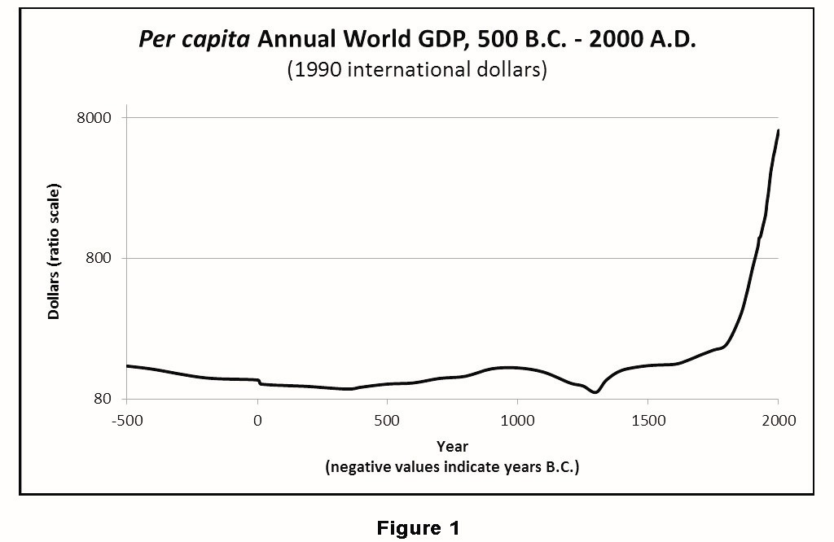
From J. Bradford De Long “Estimates of World GDP, One Million BC to Present”
http://delong.typepad.com/print/20061012_LRWGDP.pdf

Slide 5
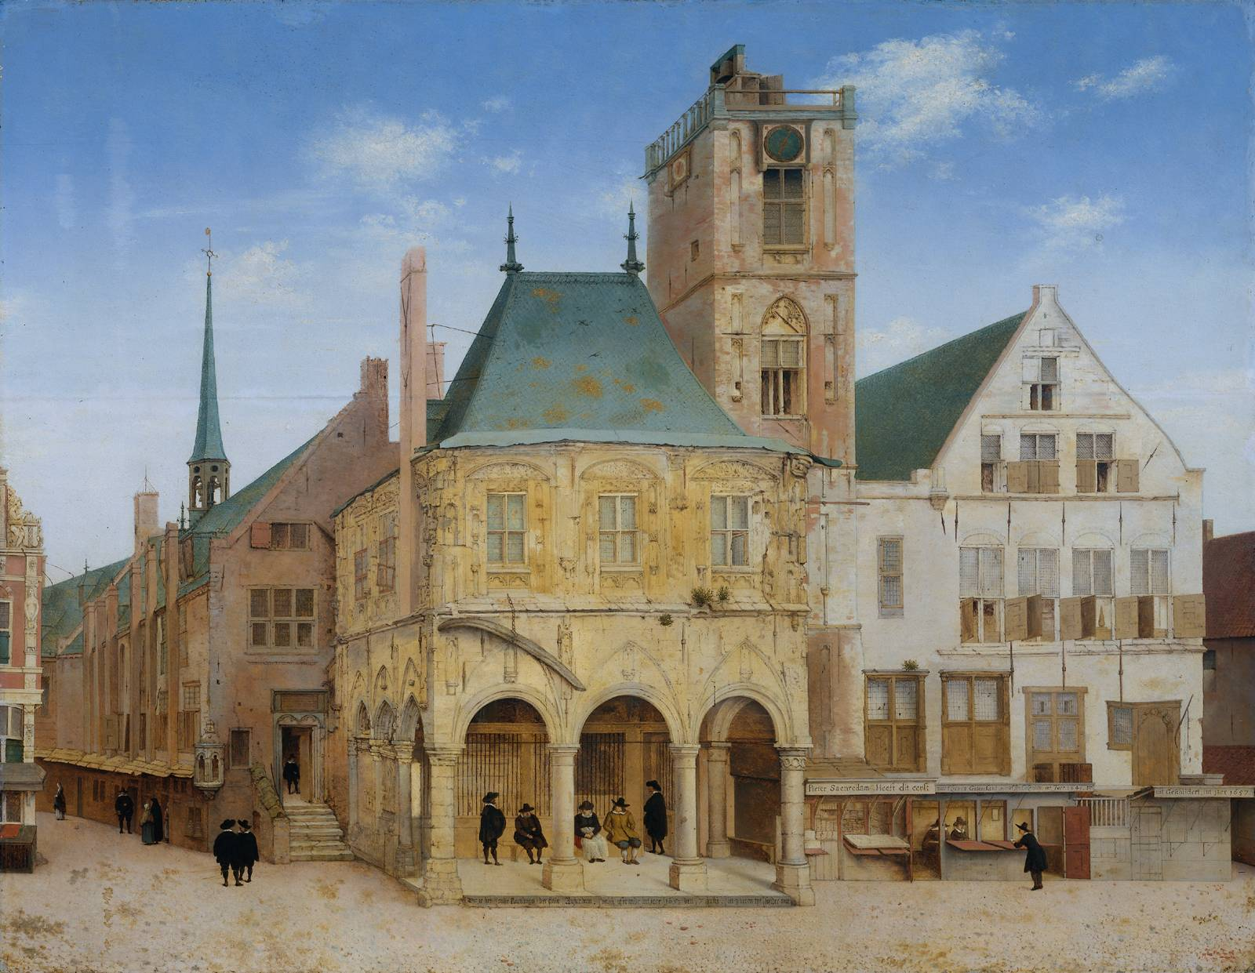
Bank of Amsterdam, 1609
Start of reserve banking (~1650)
From J. Bradford De Long “Estimates of World GDP, One Million BC to Present”
http://delong.typepad.com/print/20061012_LRWGDP.pdf

Slide 6
Reserve Banking Multiplies Money!

Slide 7
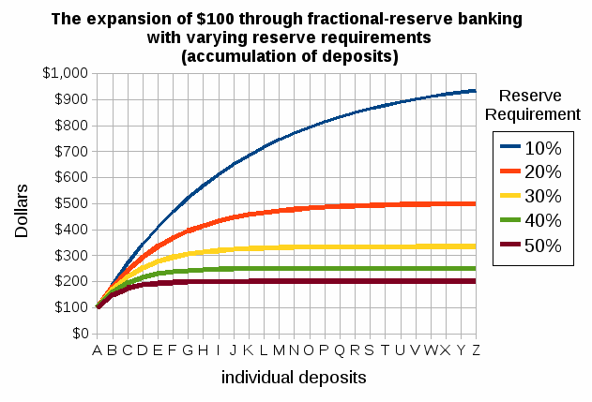
Reserve Requirement
US: 10% (banks over $103M)
China, Brazil: 20%
Switzerland: 2.5%
Eurozone: 1%

Slide 8
Jack Doerner

